Slide 1
ML23/24-09 Approve Prediction of Multisequence Learning
1
Course: Software Engineering
Lecturer: Damir Dobric / Andreas Pech
Presented by:
Mahidul Islam Rana - 1502217
MD Fazley Rabbe - 1502895
Date: 23-3-2025

Slide 2
OBJECTIVE
2
1. Main Objective:
Outline the primary goal: “To design and implement an HTM-based system that can learn and predict multiple sequences of numeric and character data.”
2. Specific Aims
Achieve robust prediction accuracy across different datasets (e.g., cancer, power consumption).
Evaluate how iterative training affects performance.
Demonstrate how simple JSON ingestion can streamline multi-sequence learning.

Slide 3
TABLE OF CONTENT
3
INTRODUCTION
HTM
METHODOLOGY
IMPLEMENTATION (LEARNING & PREDICTION STAGES)
RESULTS
CONCLUSION
REFERENCE

Slide 4
INTRODUCTION
4
HTM learns and predicts patterns from multiple time-series sequences.
JSON files feed data into a scalar encoder to create SDRs, preserving numeric/character ranges and sequence order.
Spatial Pooler extracts stable representations; Temporal Memory captures sequential dependencies.
Evaluated in cancer prediction and power consumption forecasting, ensuring high prediction accuracy

Slide 5
HIERARCHICAL TEMPORAL MEMORY (HTM)
5
HTM is a biomimetic model inspired by the neocortex’s memory prediction principles
It captures the architectural and algorithmic features of the neocortex.
HTM has demonstrated promising results in pattern recognition.
It effectively learns both the temporal sequences and spatial dynamics of sensory inputs.

Slide 6
6
METHODOLOGY
Start
Data Ingestion
Data Encoding
Spatial Pooler
Performance Reporting
Training &Testing
Temporal Memory
End

Slide 7
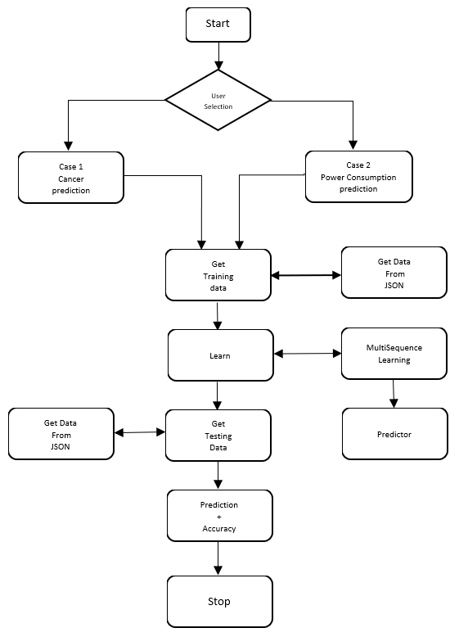
IMPLEMENTATION (LEARNING & PREDICTION STAGES)
7

Slide 8
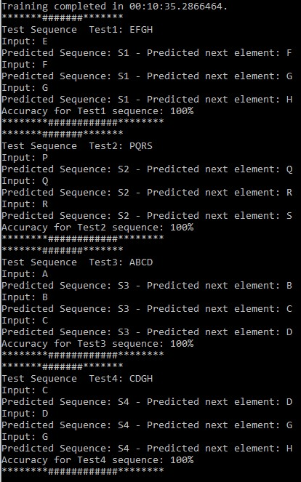
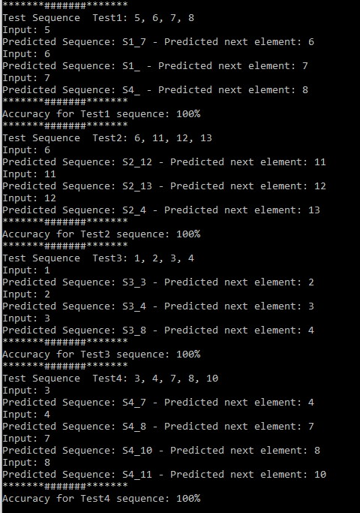
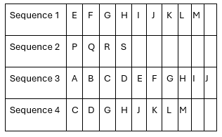
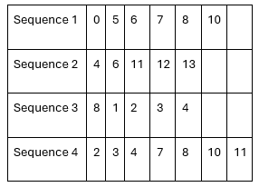
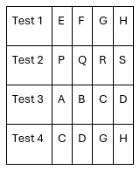
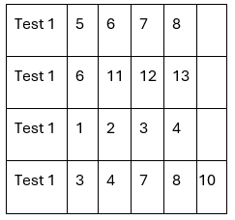
RESULTS
8
Here the given figure shown the prediction of next element for Cancer Prediction scenario and Power Consumption scenario.
Training Sequence
Training Sequence
Test Sequence
Test Sequence

Slide 9
Conclusion
9
The HTM-based system successfully transforms raw JSON data into robust Sparse Distributed Representations, enabling accurate predictions across diverse applications such as cancer and power consumption forecasting. Iterative training and automated accuracy reporting underscore the model’s strong performance and its potential for further optimization and broader application in sequence prediction tasks.

Slide 10
Thank You
10

